Slide 1

E-waste-calculator The Eco-saver-app
By Venkata Pavan Vishnu Rachapudi

Slide 2
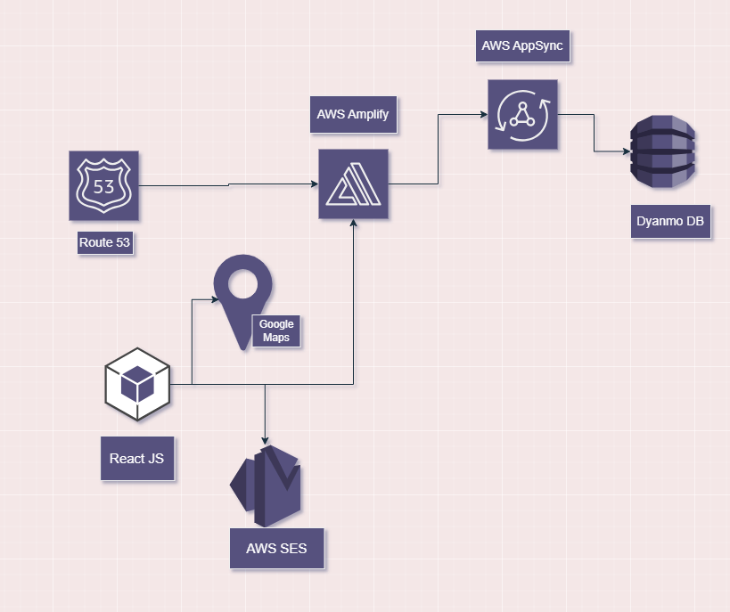
Tech Stack used
AWS Amplify gen2 Data and hosting
React js and node js
Google Maps API integration using maps and markers.
AWS SDK for JavaScript to interact with AWS services.
Amazon SES for sending emails programmatically.
AWS Route53 for domain registration

Slide 3

What is E-Waste? Why we need to pay attention
E-waste, or electronic waste, refers to discarded electronic devices like computers, smartphones, and televisions. It's a rapidly growing waste stream due to the fast-paced technology upgrades and short product lifecycles. Toxic Threat: Improper disposal can lead to soil, air, and water pollution, impacting ecosystems and communities.
Recycling Potential: Recycling e-waste can conserve natural resources, save energy, and reduce mining impacts.
Global Responsibility: Addressing e-waste requires international cooperation, stricter regulations, and consumer awareness.
Future Focus: Promoting repair, reuse, and eco-friendly designs can help curb the e-waste crisis for a greener future.

Slide 4

What are we offering?
Eco Points for E-Waste: Drop off your electronic waste and earn "Eco Points" as a reward for responsible recycling. Every item you recycle helps make a positive environmental impact.
Track Your Environmental Impact: The app provides detailed insights on how much aluminum, lead, plastic, and other materials you've saved from landfills, highlighting your contribution to sustainability.
Rewards & Vouchers: Accumulate Eco Points to unlock exciting rewards such as exclusive vouchers, discounts, or gift cards. The more Eco Points you earn, the bigger and better the rewards!

Slide 5

What next ?
Easy Collection: Once you submit your e-waste collection form, our trusted e-waste partner will arrange for pick-up directly from your location, making the recycling process seamless.
Check Your Progress: Keep track of your Eco Points anytime by visiting the "About" page in the app. Once you reach 1000 Eco Points, an automatic email is triggered, notifying you of your reward and providing a voucher for your efforts.
By recycling e-waste through this app, you contribute to reducing harmful electronic waste, recovering valuable materials, and supporting eco-friendly initiatives. Your efforts not only help the environment but also allow you to earn exciting rewards along the way!

Slide 6
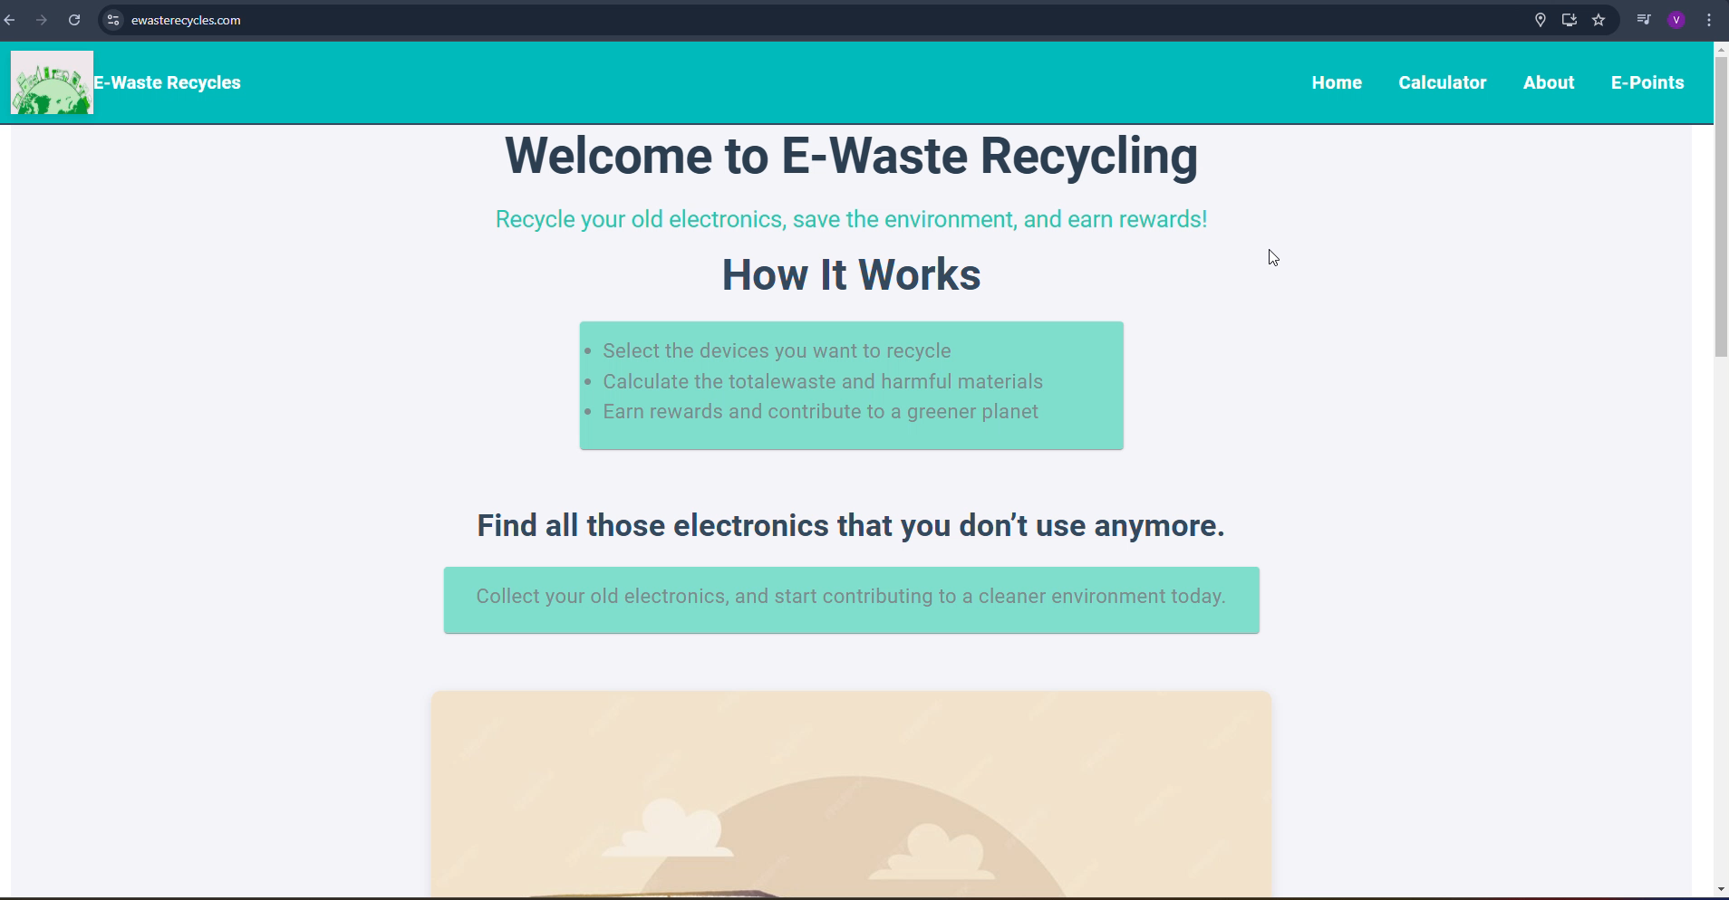
Demo

Slide 7
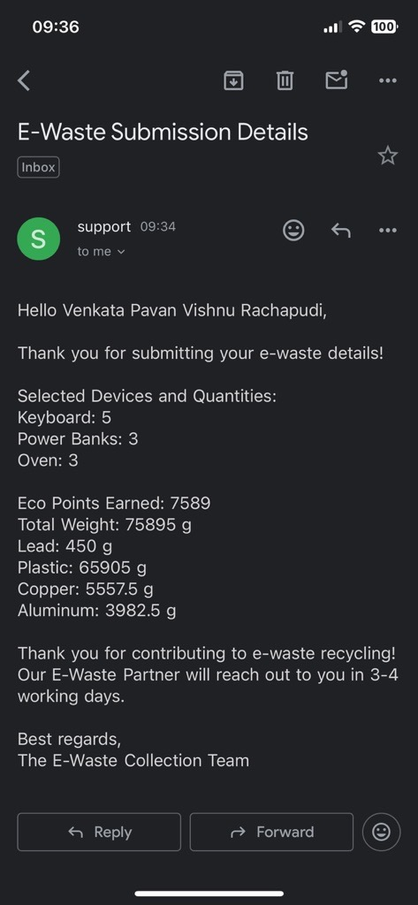
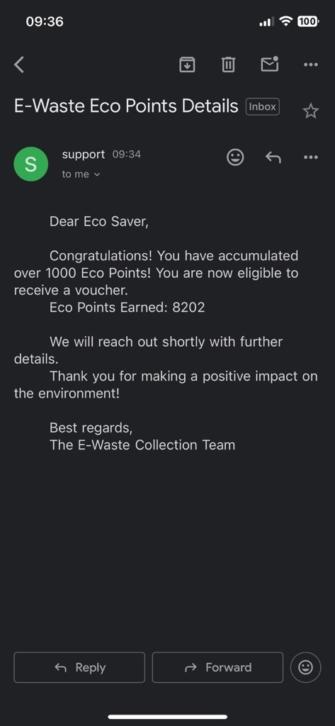

Slide 8
In detail
When submitting a form with e-waste details you will receive an email, and you won't receive an email if the details are empty.
In the second screenshot, you can view your eco-points on the "About" page, and your phone number and email will be valid. Once your eco-points reach 1000, the system will automatically trigger an email and reset your eco-points to 0.
Also ,we will send a confirmation email. once e-waste materials has been received from the e-waste partner.

Slide 9
In detail
Data Preservation: We only store your email, name, phone number, and eco-points. If you resubmit the form with the same details, only your eco-points will be updated in our system.
Checking Your Eco-Points: To view your current eco-points, visit the About page. Make sure that your phone number and email are valid to ensure accurate tracking.

Slide 10
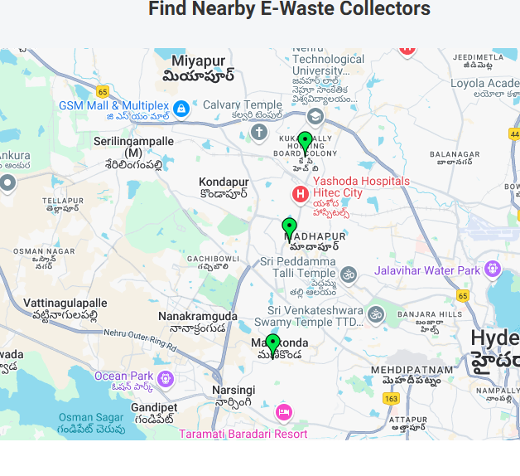
Limitations and Future Enhancements
In this App we are using AWS-SES , which offers a sandbox environment where emails won't be triggered to unverified emails.(Still E-waste data & form data will loaded into database) In real world , we can apply for production environment and get it Seamless Emails Transactions.
Google Map markers in the maps tells you nearest E-waste collection points (will be achieved with partners)
Tying up with some e-waste partners and providing some exciting coupons once you hit 1000 ecopoints

Slide 11
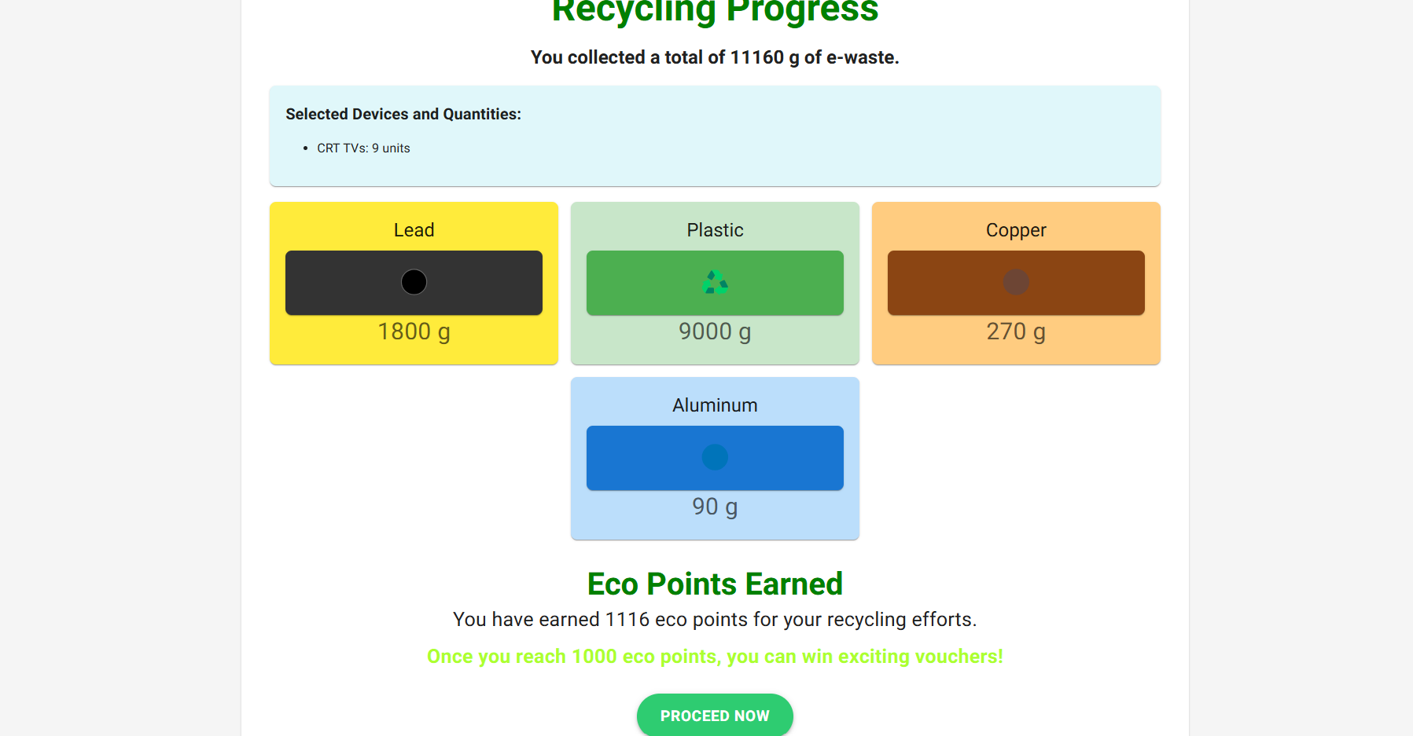

Slide 12
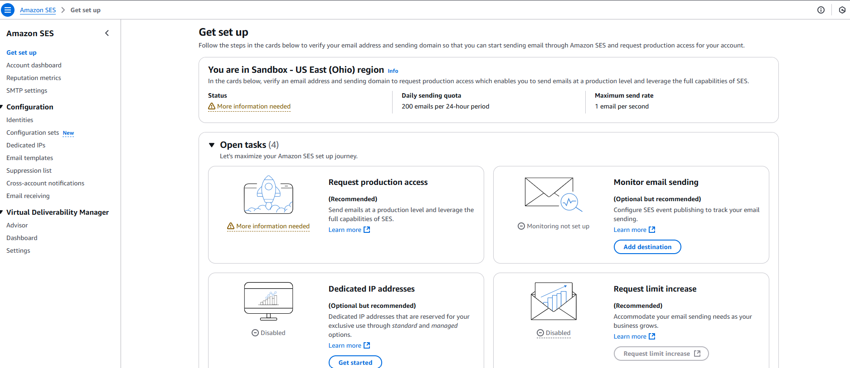
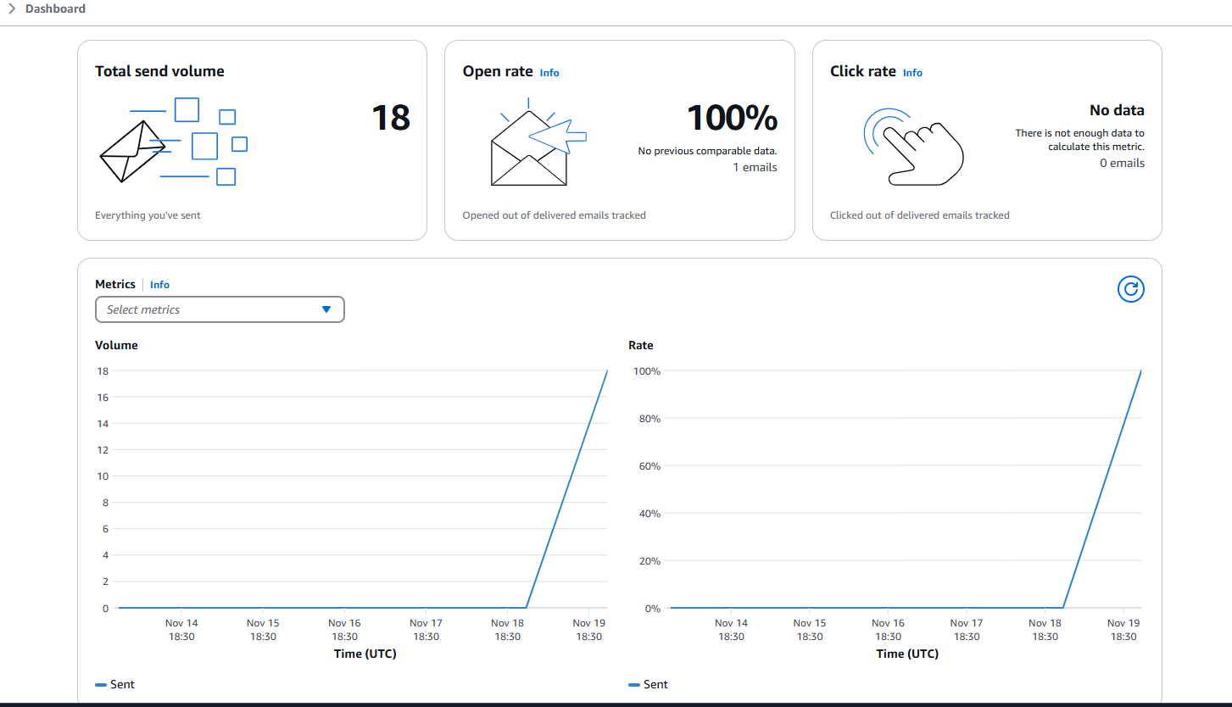
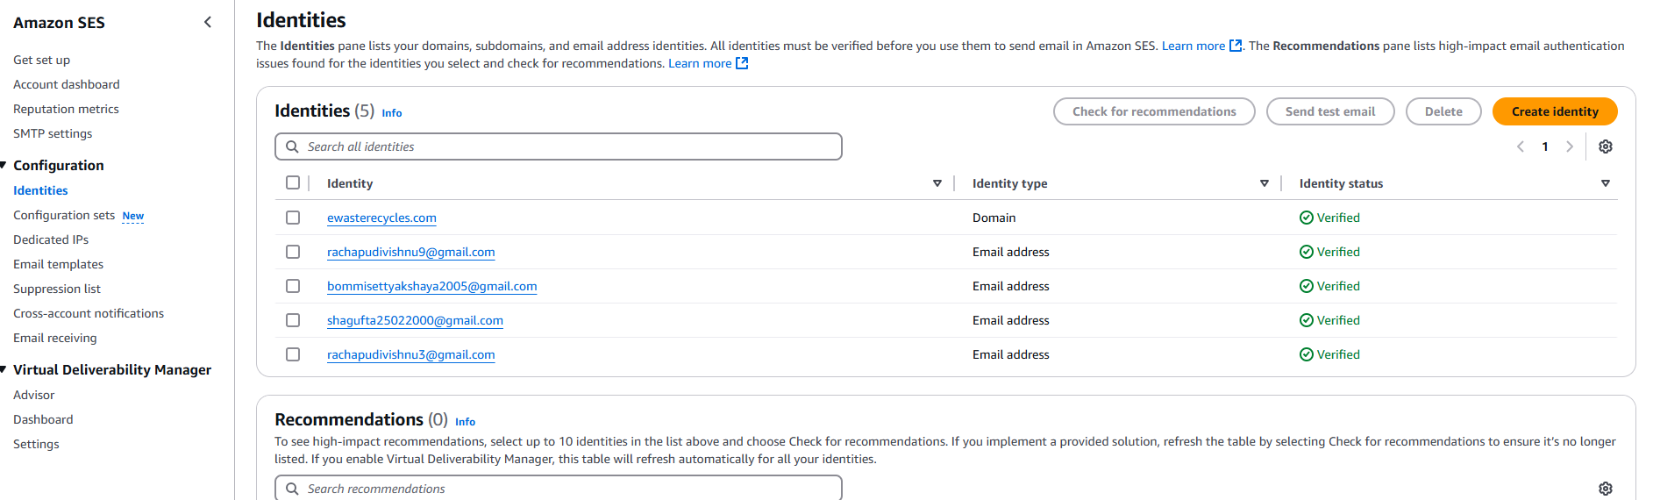

Slide 13

Thanks

